Slide 1
ABS Data Explorer
Built a tool to visualize Australian bureau of statistics data
Data at various levels
Postcode
Suburb
Statistical Area 1 (Sa1)
Area much more granular than a suburb
it usually encompasses a couple of blocks
In average there are ~400 people per sa1
Different types of data
Health data
Age data
Income data
Country of residence data
Household type data
Education and work data
Easily open to more data

Slide 2
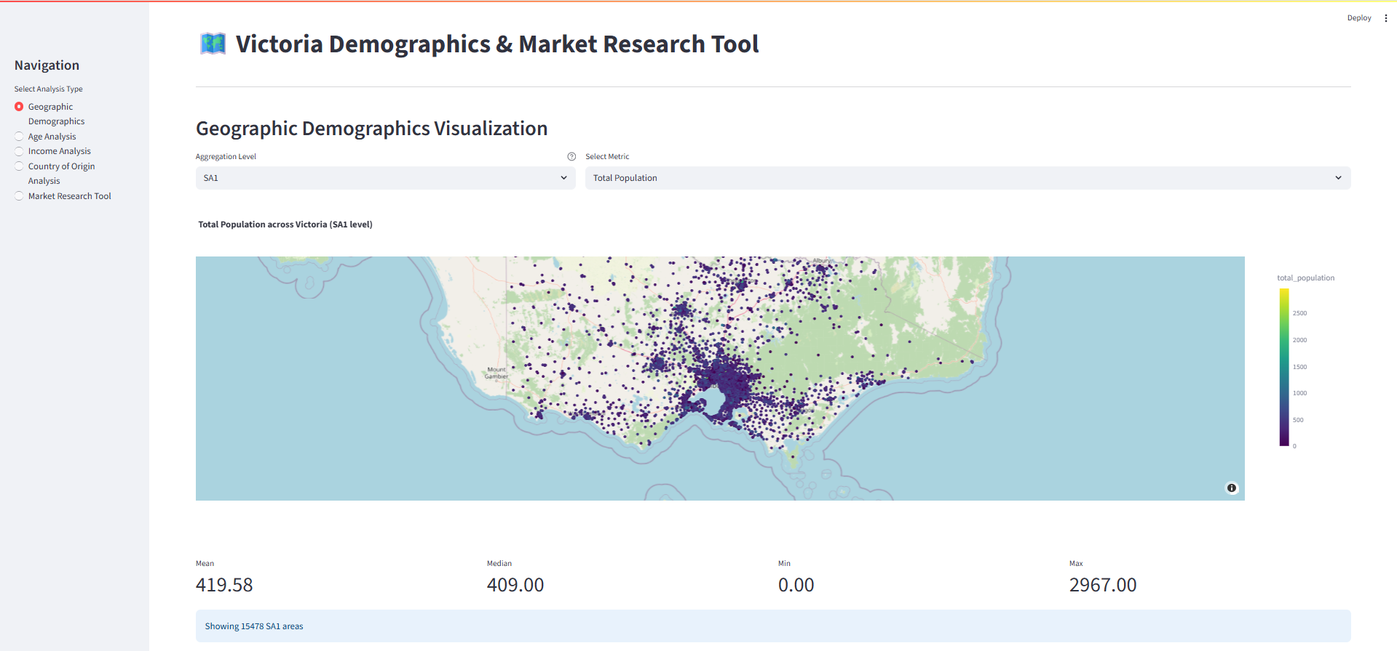
Several functionalities: First one, demographic visualization on a map

Slide 3
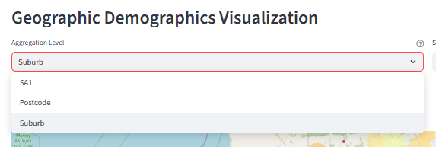
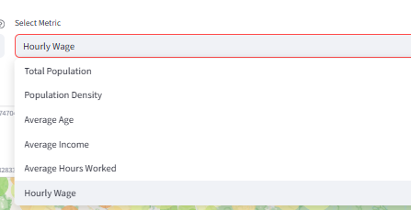
Multiple granularity levels and metrics to choose from

Slide 4
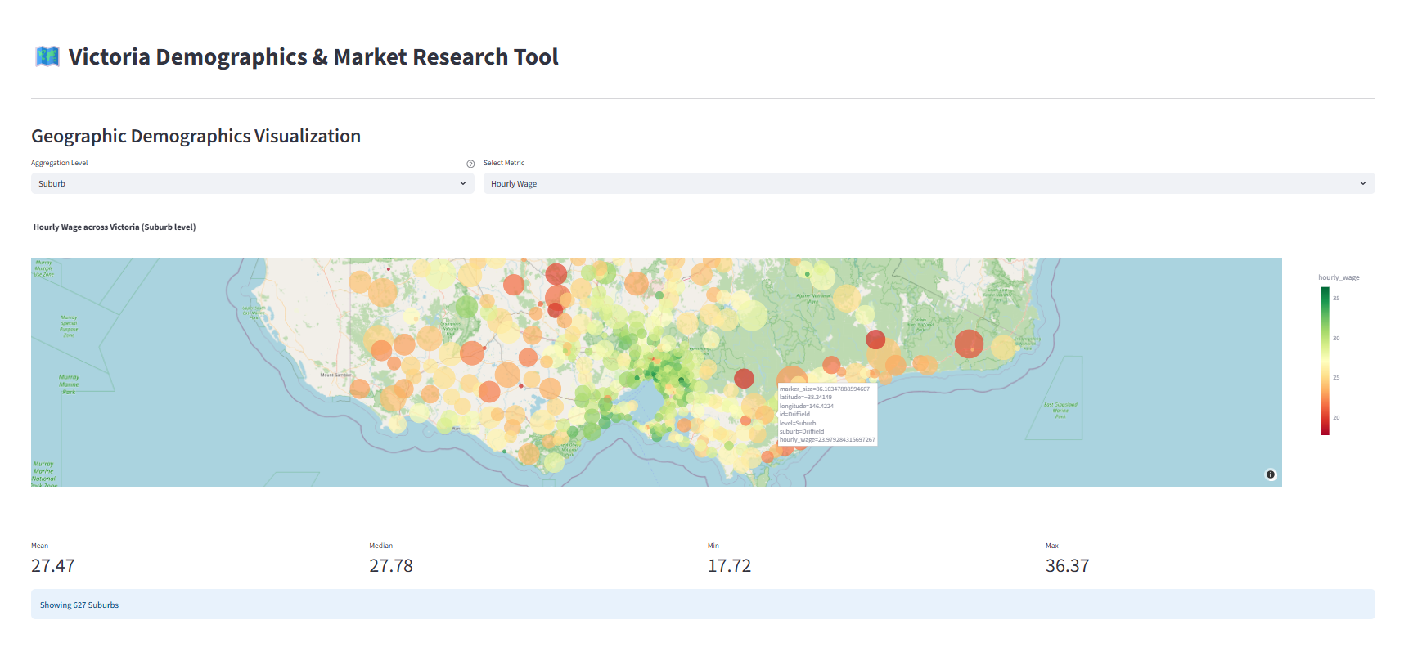
You can visualize in the map, zoom in, zoom out, get details of the datapoint

Slide 5
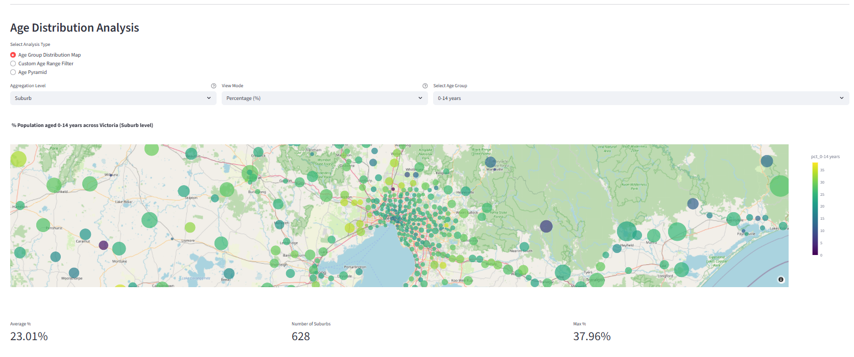
Age distribution across geographical areas, either count level or % level

Slide 6
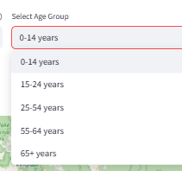
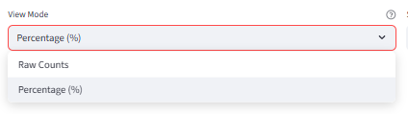
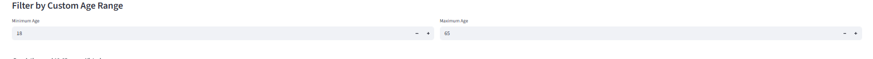
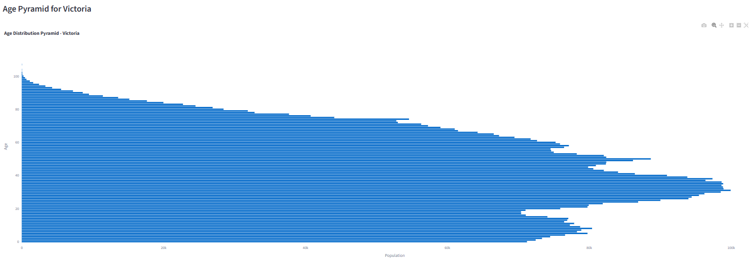
Preset age groups,
custom age ranges,
and age distribution chart

Slide 7
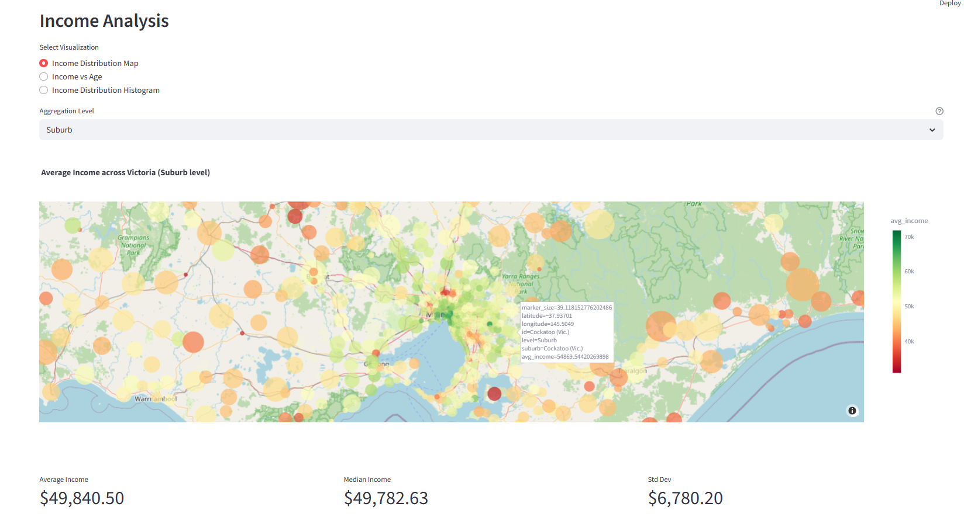
Income analysis

Slide 8
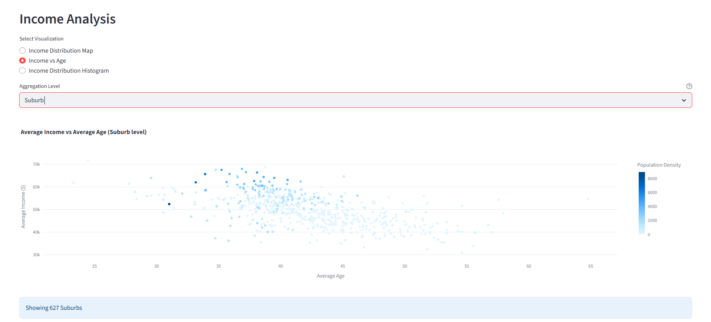
Income vs age analysis

Slide 9
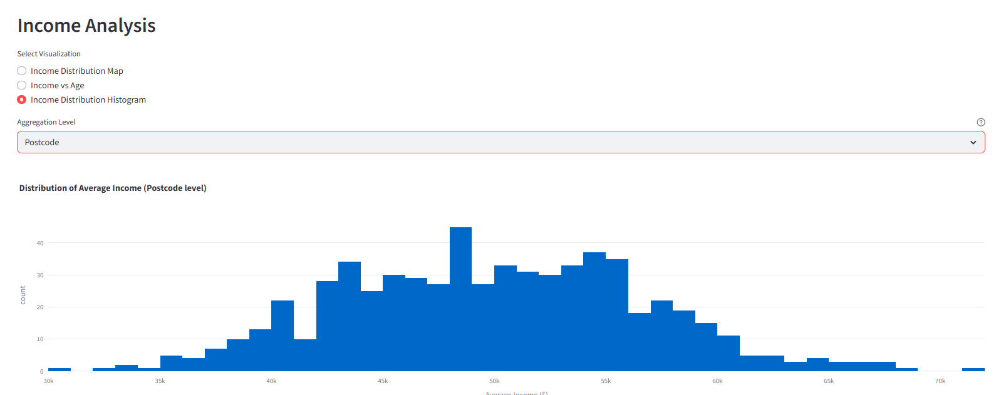
Avg income distribution per geographical area

Slide 10
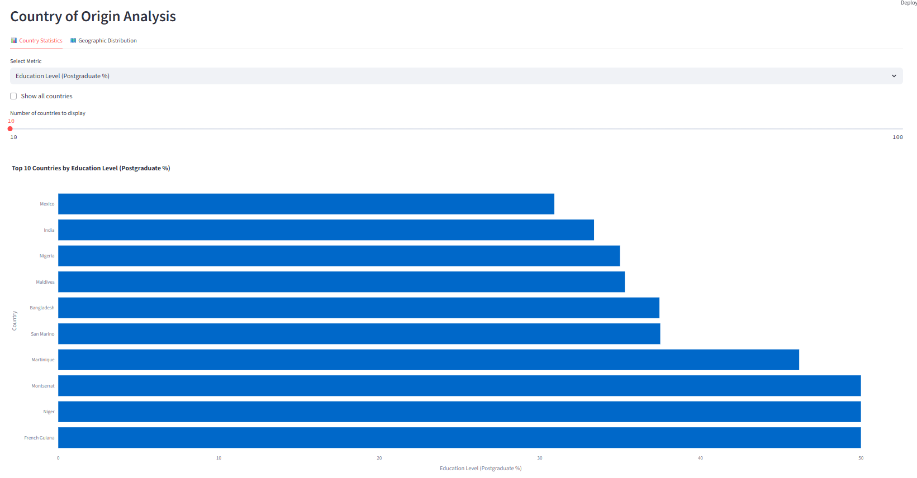
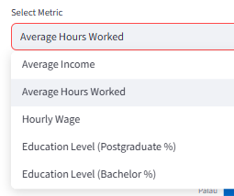
Analysis based on country of origin
Select variable, select number of countries to rank/compare

Slide 11
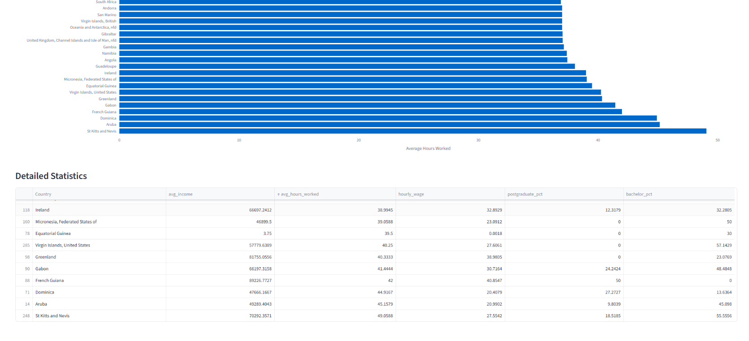
Get a detailed analysis & list to have a closer look

Slide 12
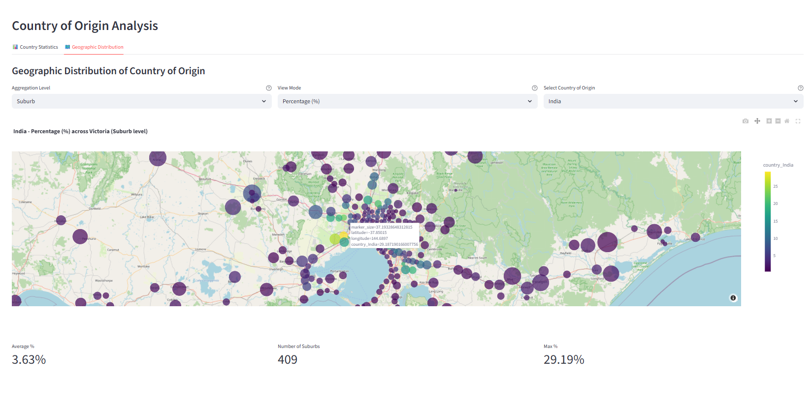
Find where the communities from different countries are located, identify hotspots for a particular culture

Slide 13
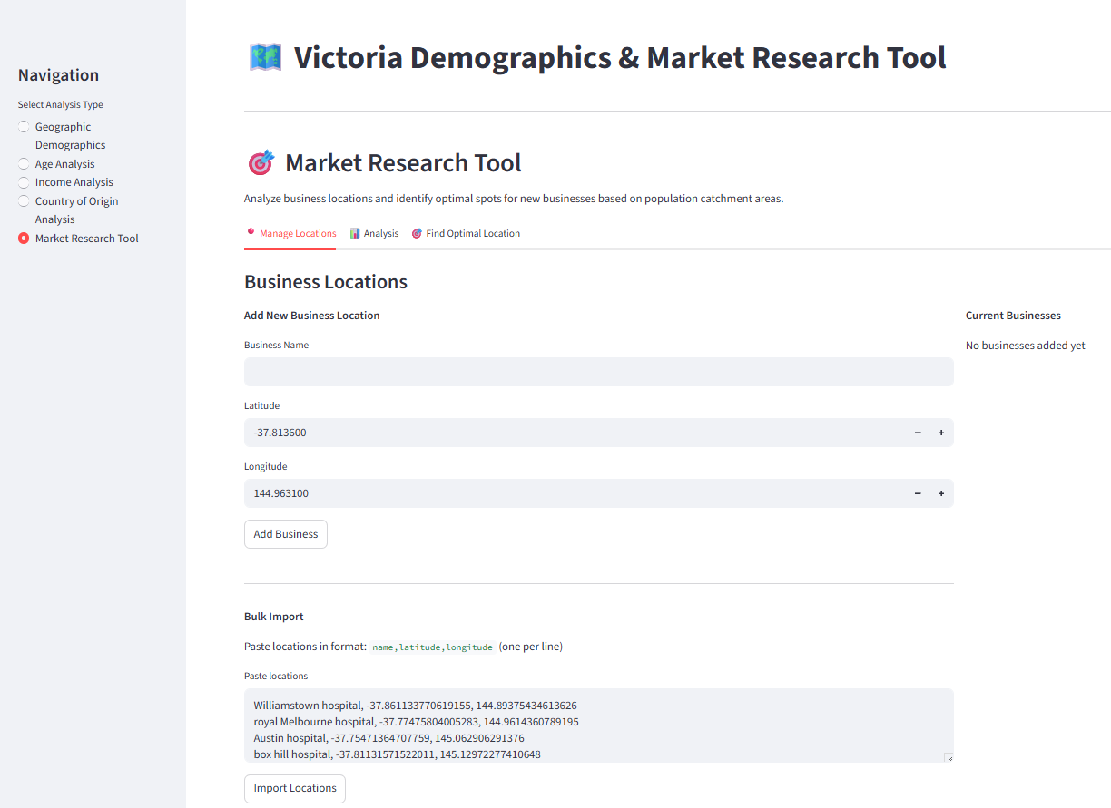
Add in a list of businesses and their locations to get some insights about their potential/likely market

Slide 14
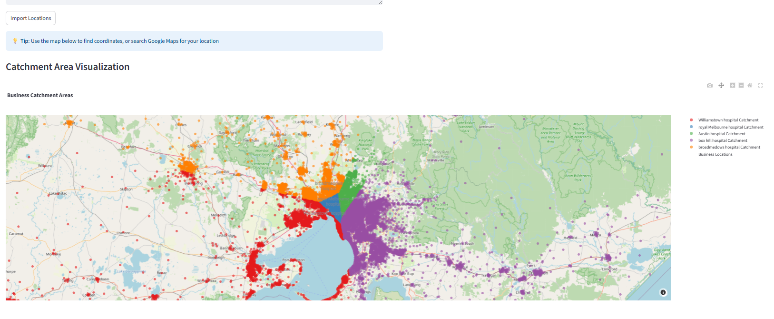
Visualize population distribution amongst the selected businesses / locations

Slide 15
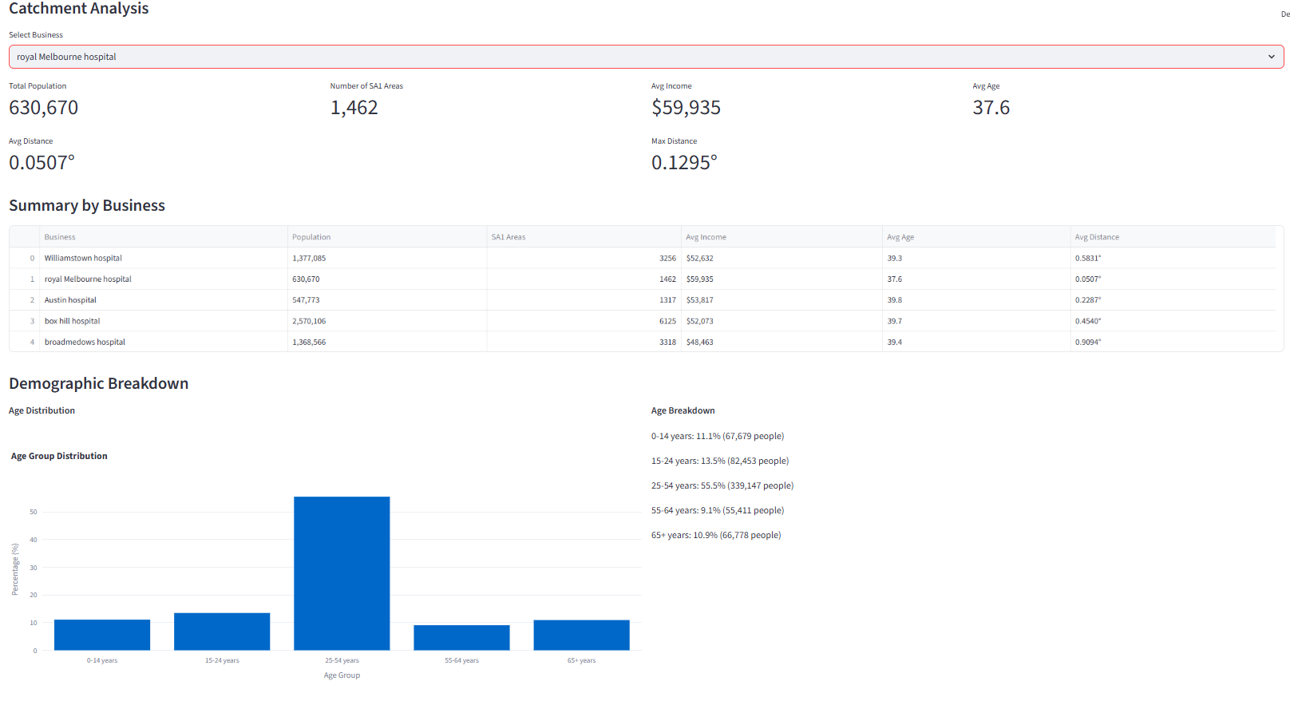
Get some insights about the population captured by each

Slide 16
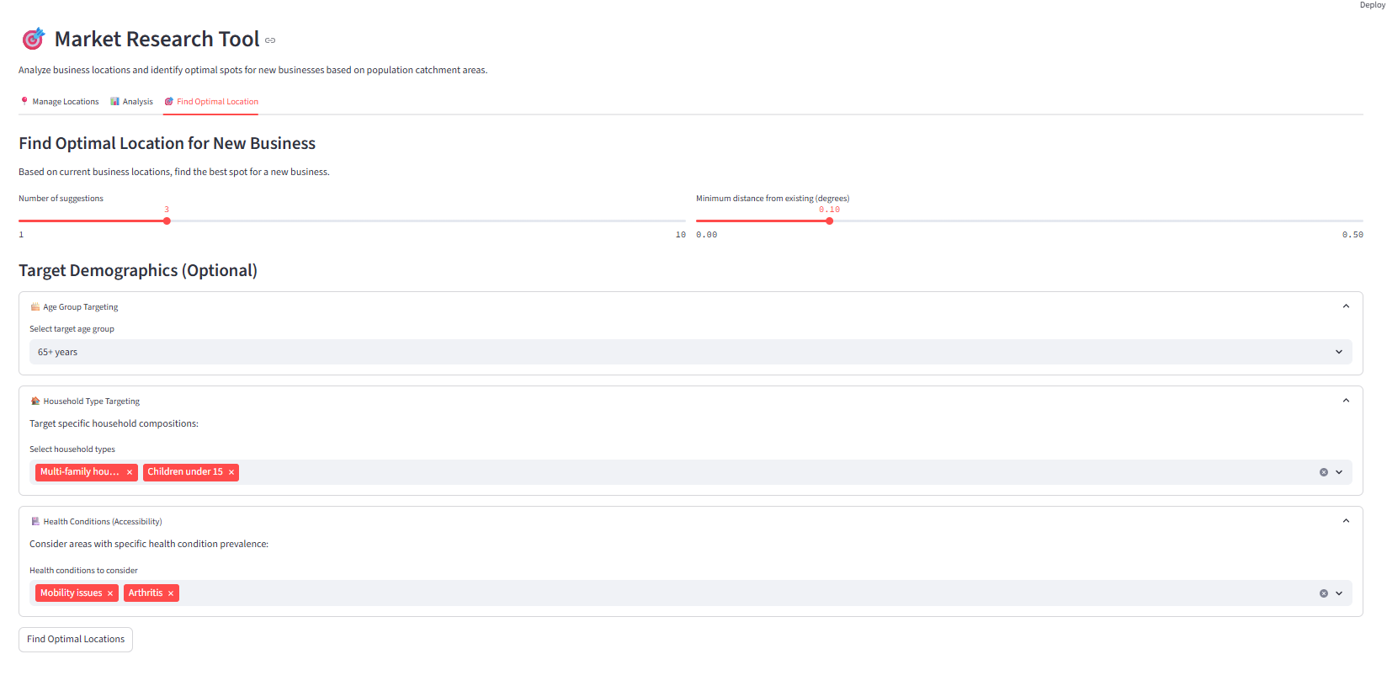
Use this information to identify potential spots optimally located to target specific demographics

Slide 17
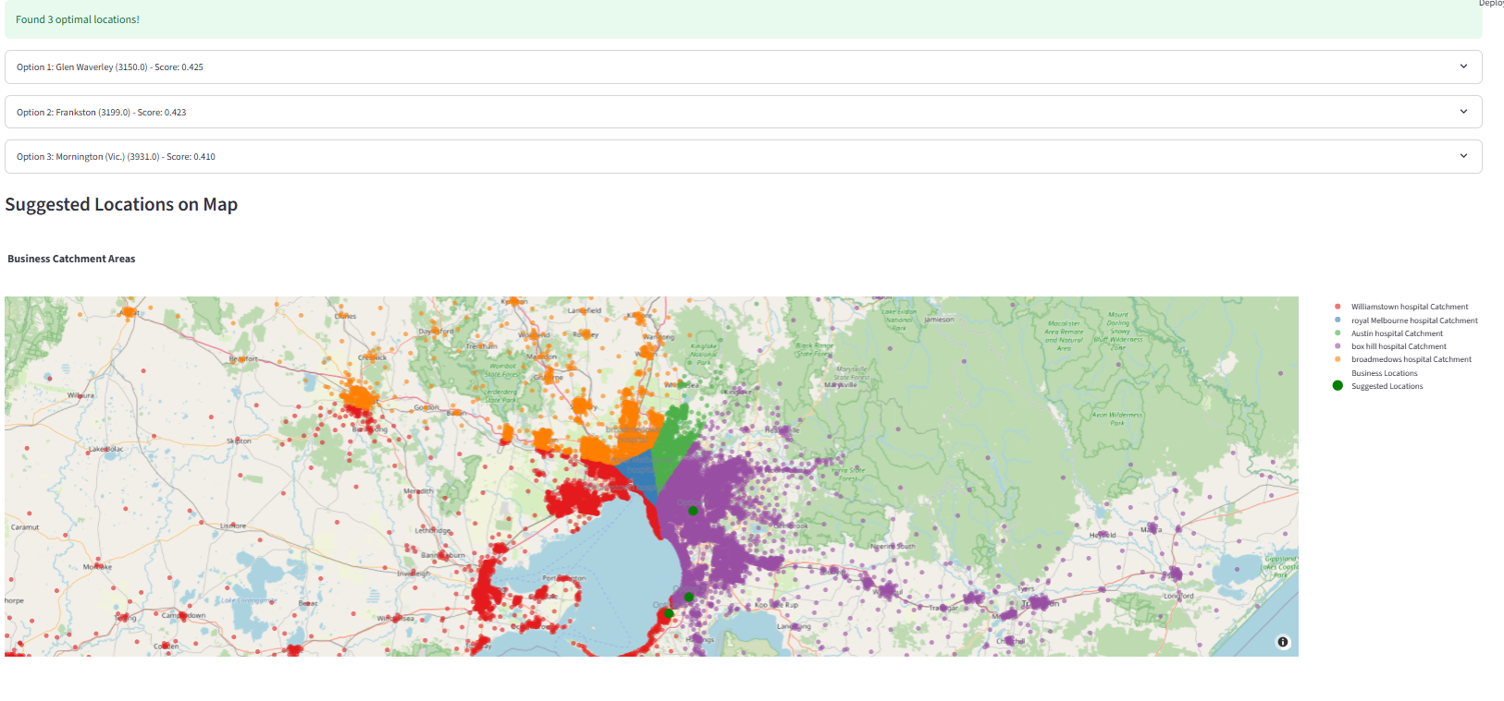
Get as many targeted recommendations for the chosen demographics as selected so you can further analyze and compare

Slide 18
Next Steps
Mainly add more data
Enormous possibilities for enhancing this further

